Slide 1



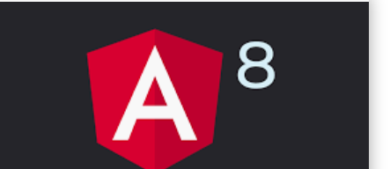



Slide 2
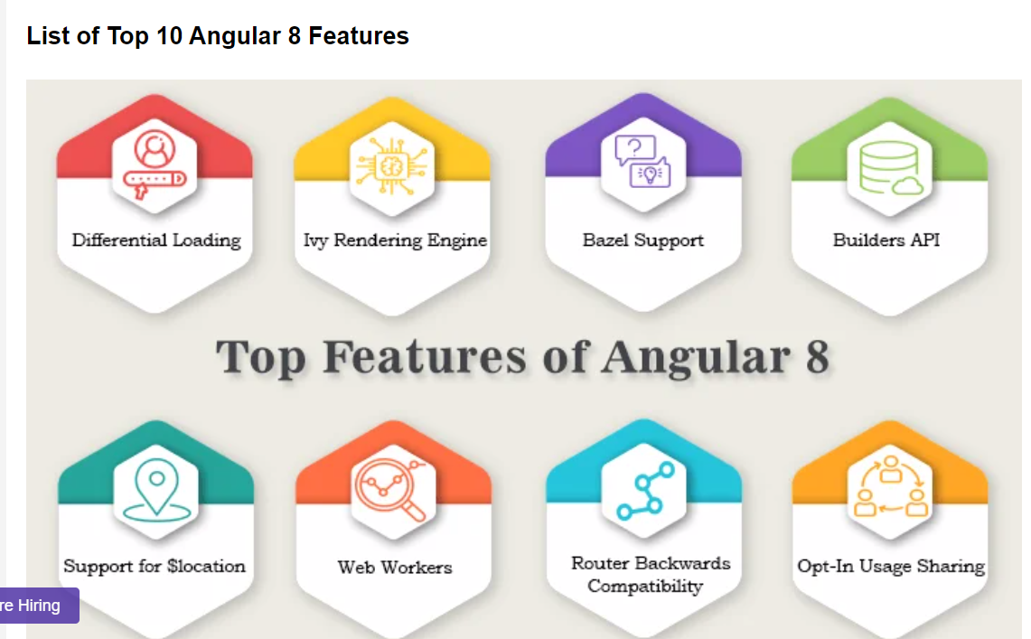

Slide 3

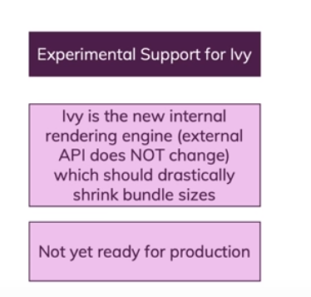
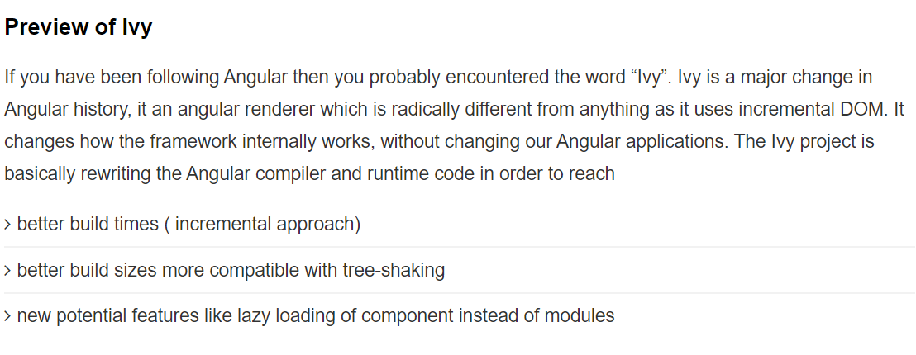

Slide 4
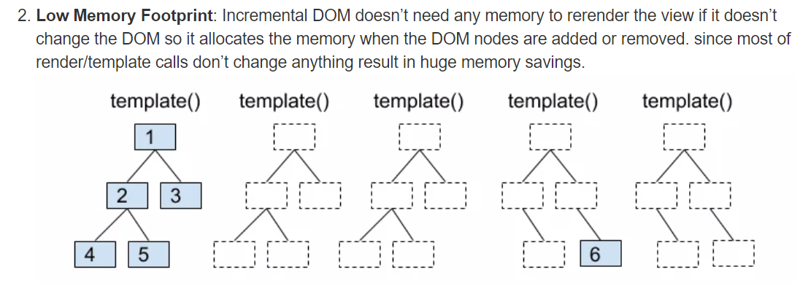

Slide 5
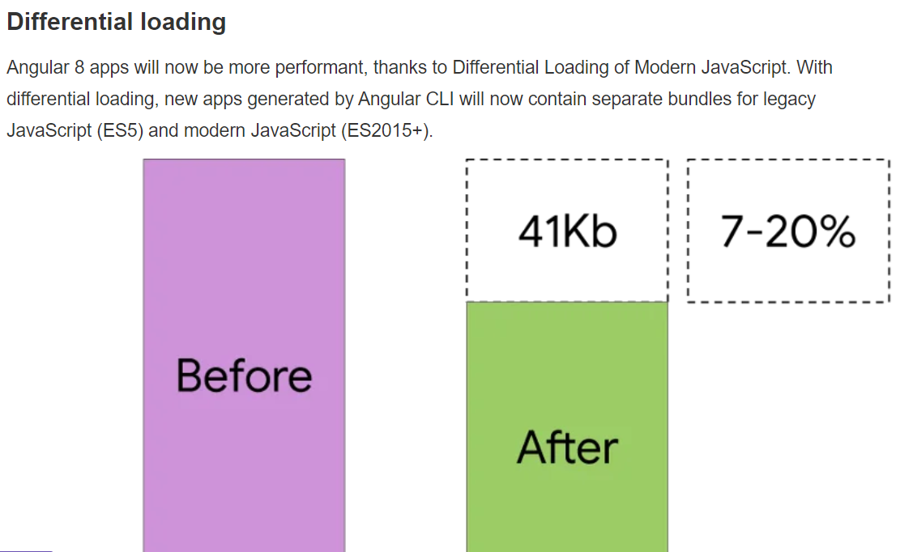

Slide 6
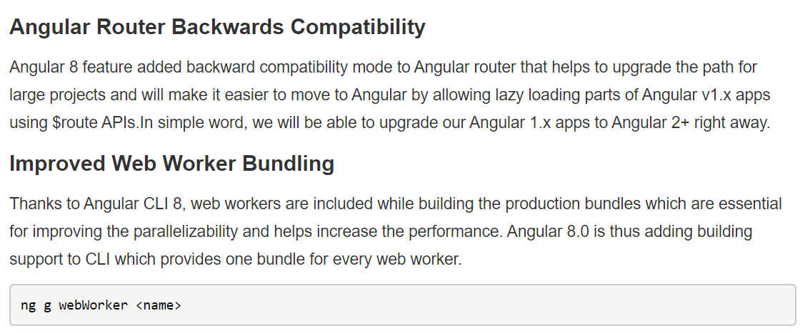

Slide 7
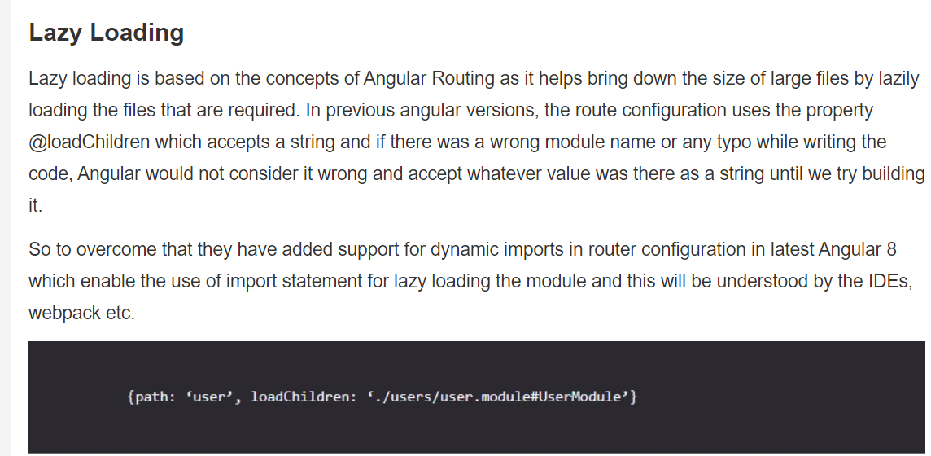

Slide 8
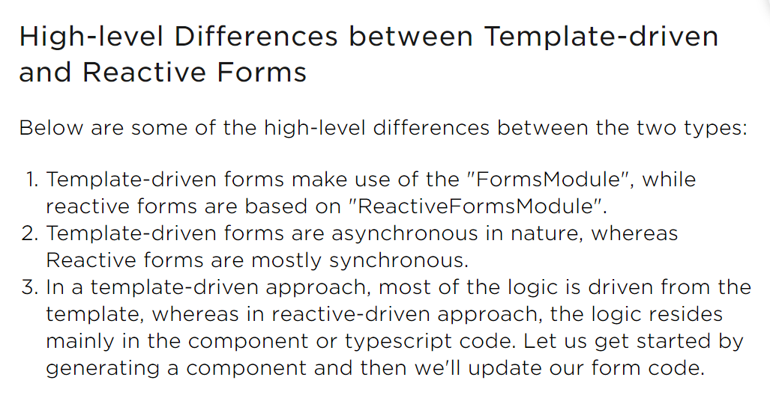

Slide 9
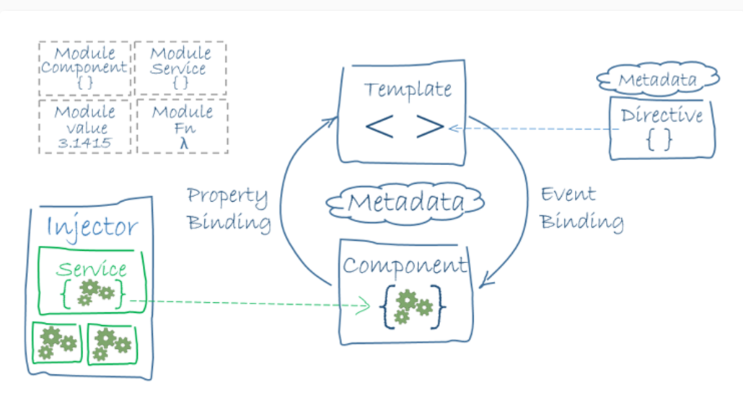
Architecture Overview

Slide 10
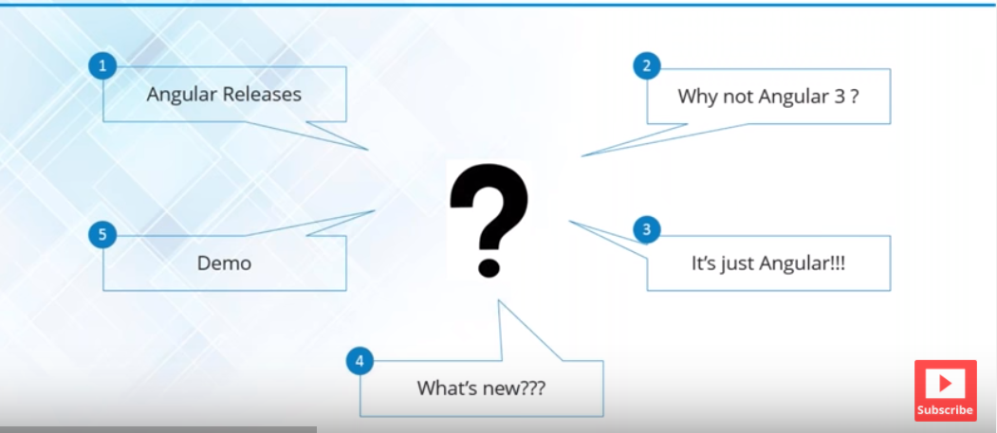

Slide 11
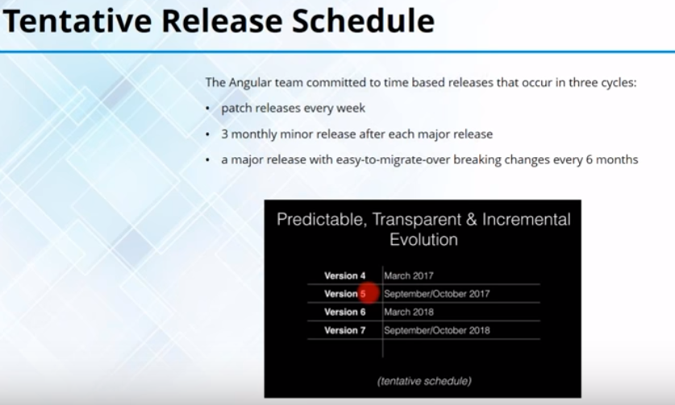

Slide 12
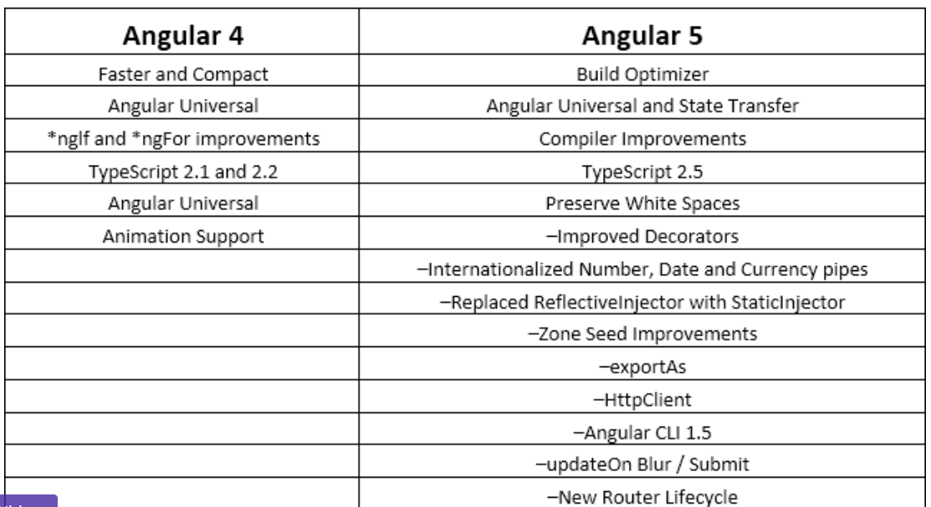

Slide 13
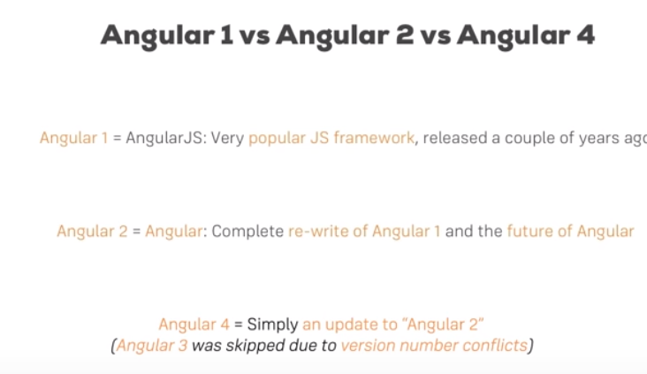

Slide 14
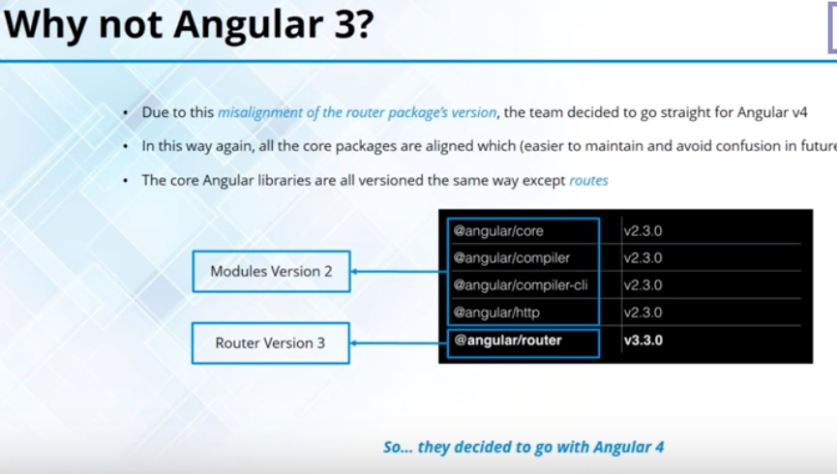

Slide 15
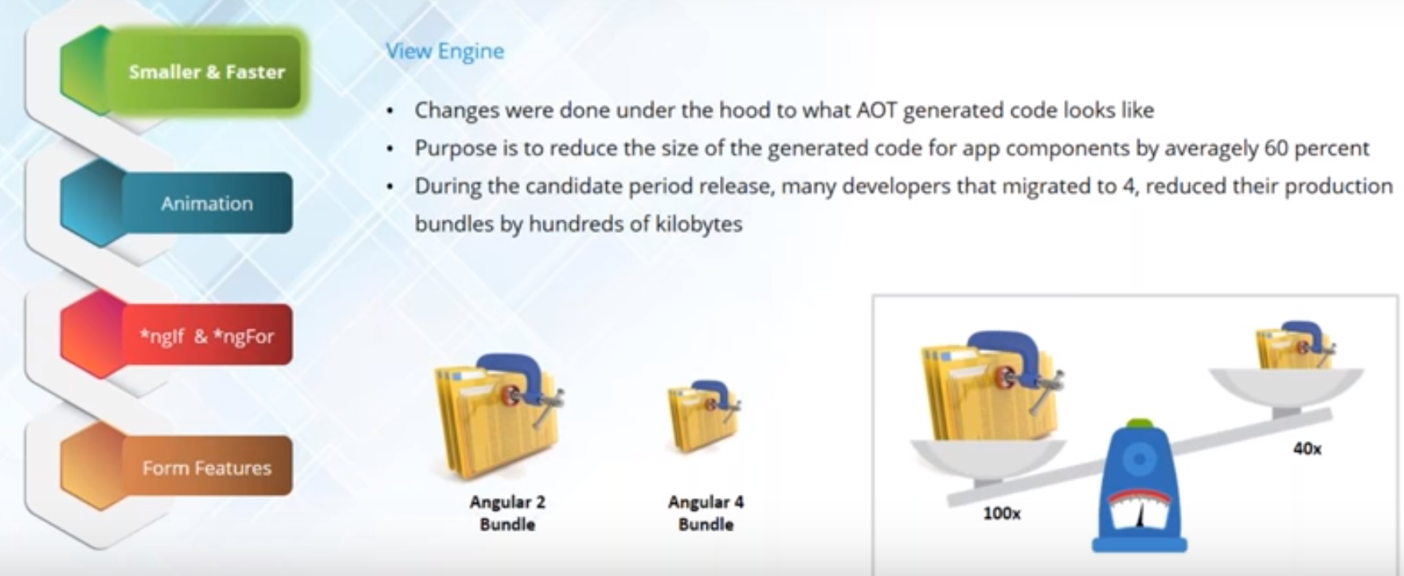
Smaller & Faster

Slide 16
Lets Create the Project !!!
?????????????????

Slide 17
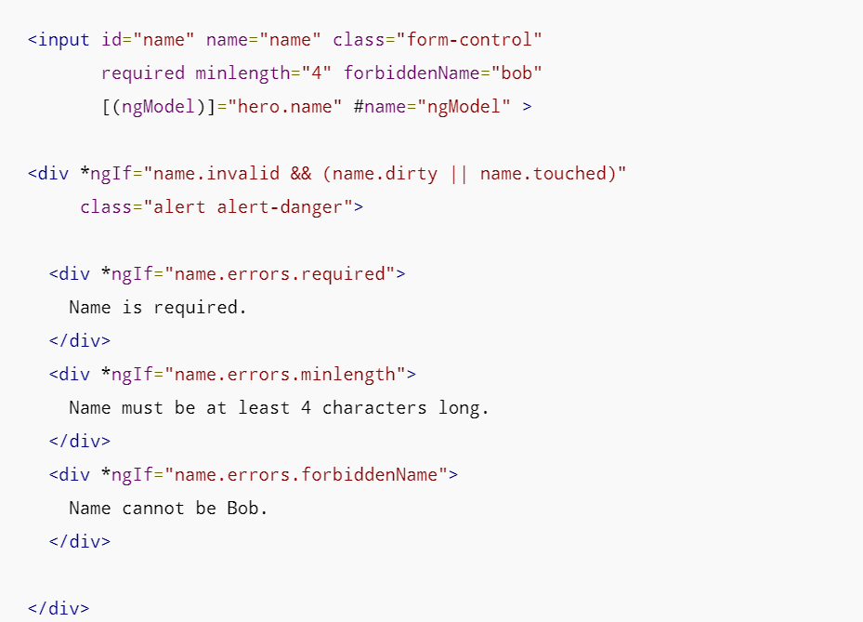
Form Validation

Slide 18
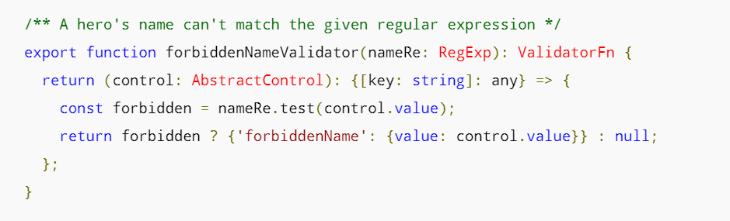
Custom Validator
https://angular.io/guide/form-validation

Slide 19
Animation Example :-> http://plnkr.co/edit/AfIB1i?p=preview
Animation Example

Slide 20
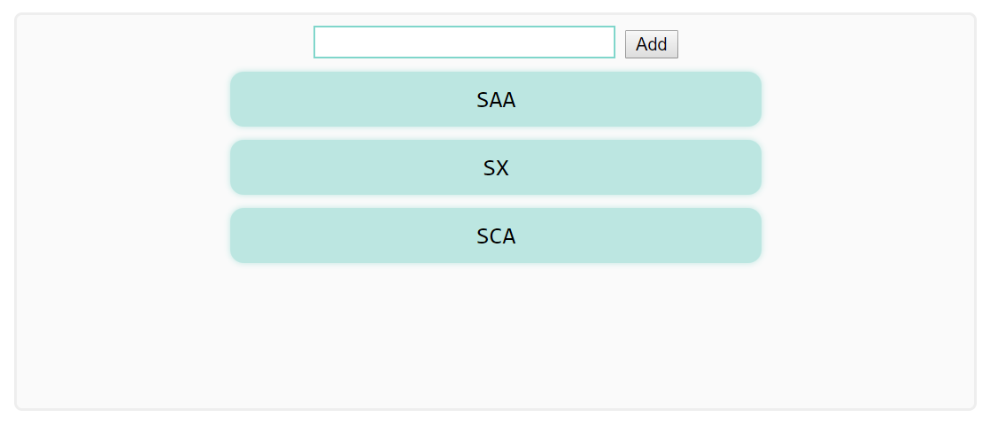
Basic Animation

Slide 21
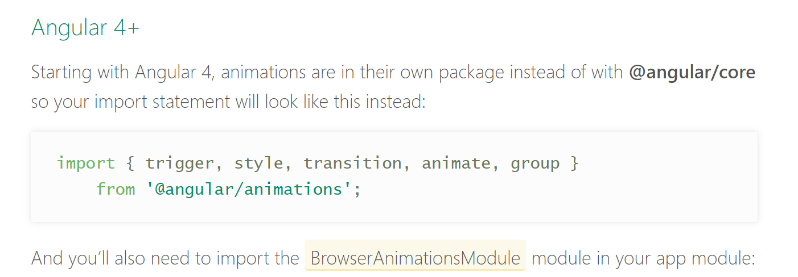

Slide 22
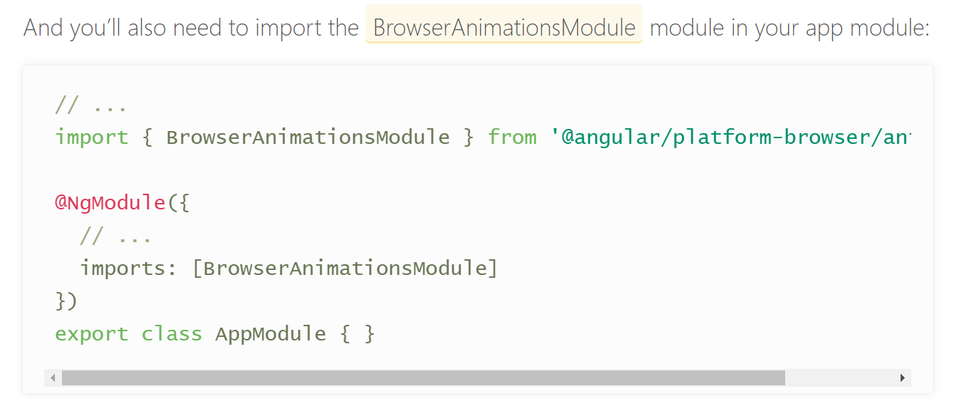

Slide 23
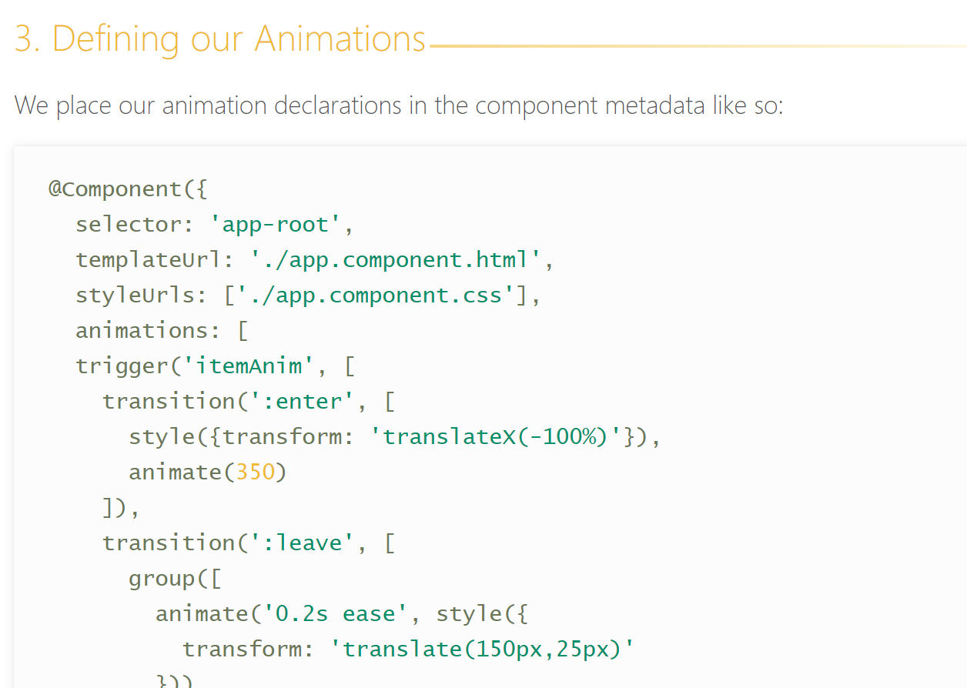

Slide 24
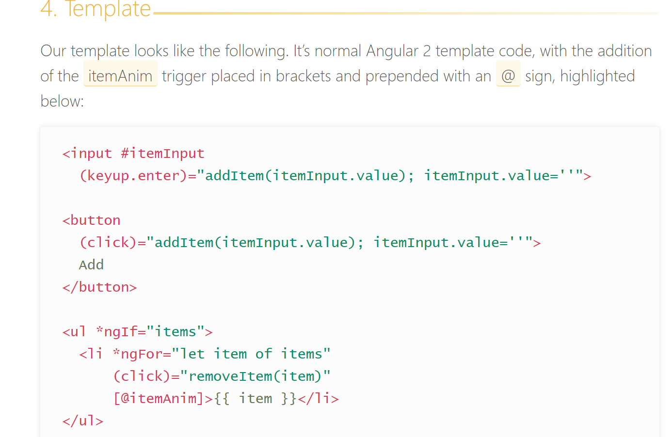

Slide 25
Refernece of Code :→
https://alligator.io/angular/animation-angular/

Slide 26
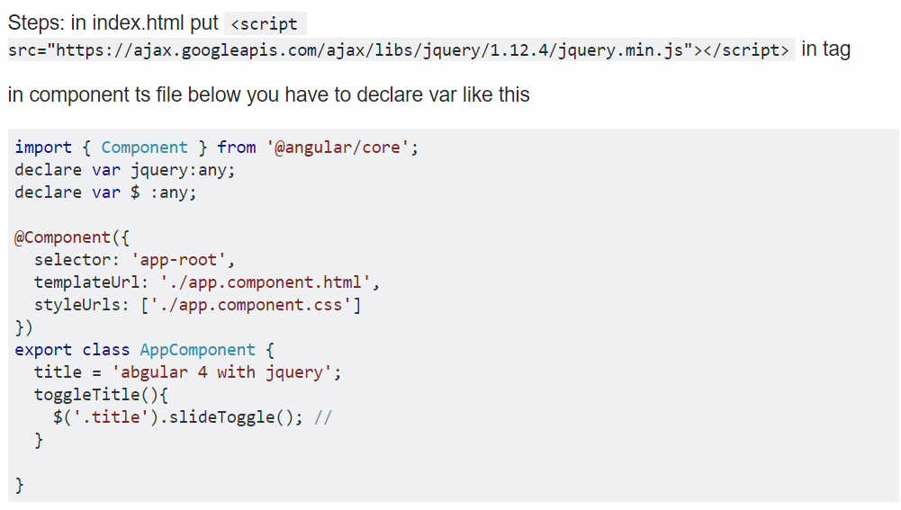
Add Jquery

Slide 27
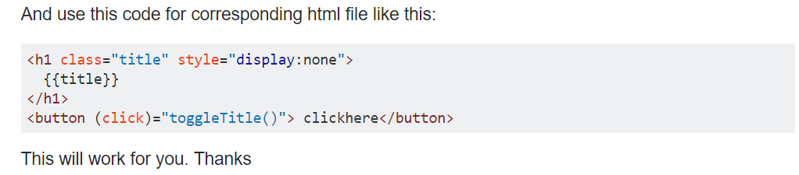
Add code in HTML

Slide 28
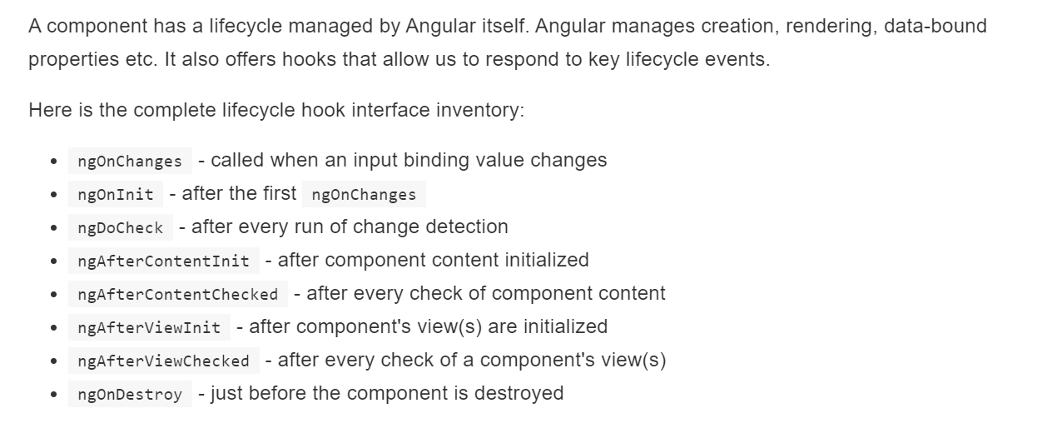
Component Life Cycle

Slide 29
Child to Parent: Sharing Data via ViewChild
ViewChild allows a one component to be injected into another, giving the parent access to its attributes and functions. One caveat, however, is that child won’t be available until after the view has been initialized. This means we need to implement the AfterViewInit lifecycle hook to receive the data from the child.

Slide 30
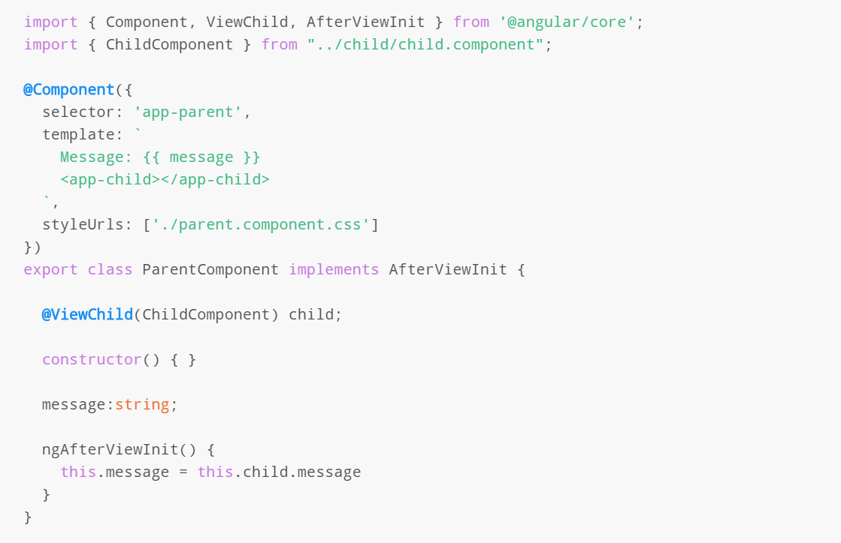
parent.component.ts

Slide 31
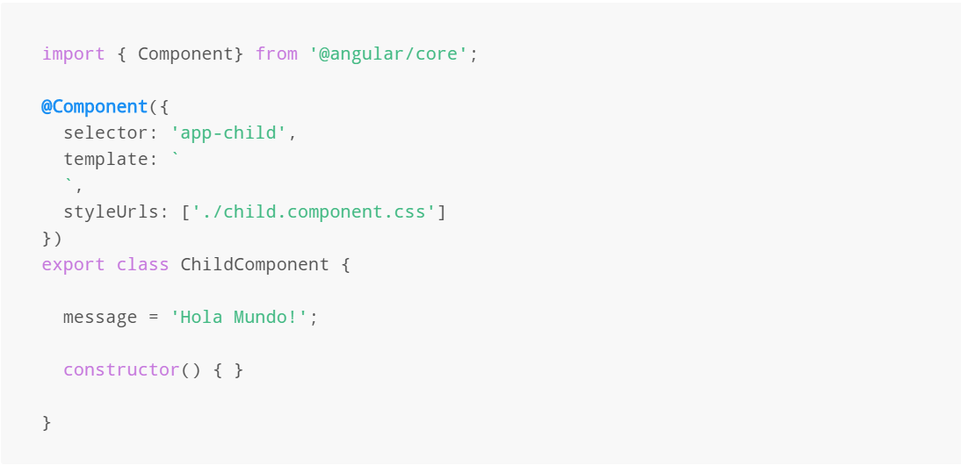
child.component.ts

Slide 32
Child to Parent: Sharing Data via Output() and EventEmitter
1. Another way to share data is to emit data from the child, which can be listed to by the parent. This approach is ideal when you want to share data changes that occur on things like button clicks, form entires, and other user events.
In the parent, we create a function to receive the message and set it equal to the message variable.
In the child, we declare a messageEvent variable with the Output decorator and set it equal to a new event emitter. Then we create a function named sendMessage that calls emit on this event with the message we want to send. Lastly, we create a button to trigger this function.
The parent can now subscribe to this messageEvent that’s outputted by the child component, then run the receive message function whenever this event occurs.

Slide 33
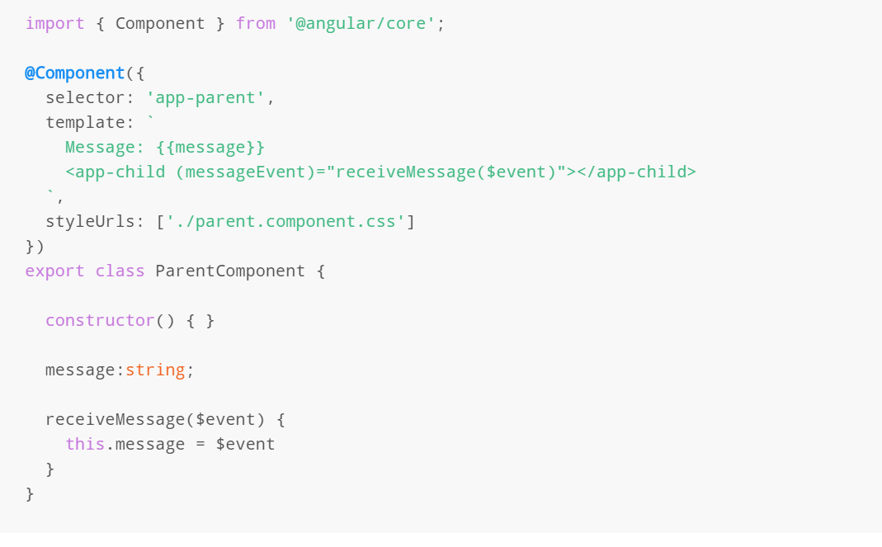
parent.component.ts

Slide 34
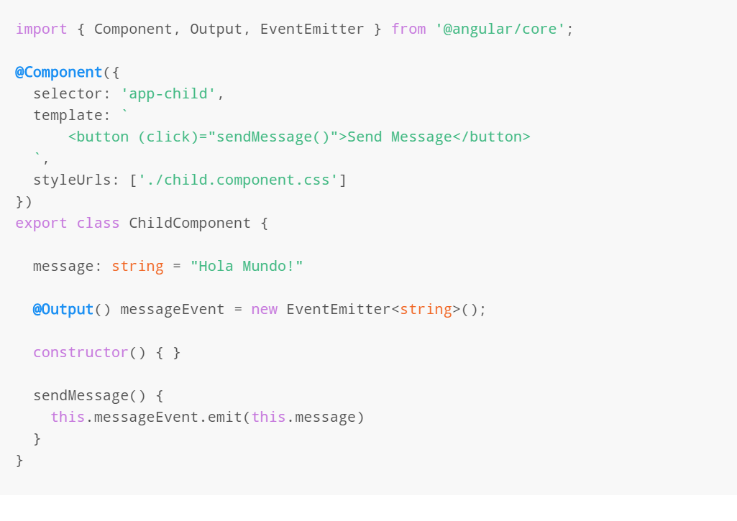
child.component.ts

Slide 35
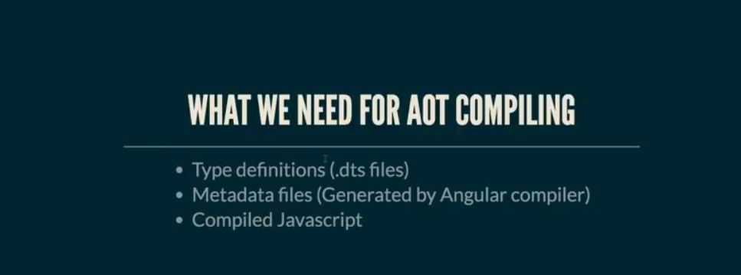
Create Lib & Publish Module for AOT

Slide 36
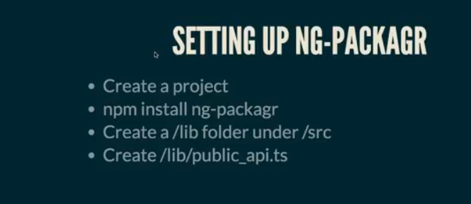
NG-PACKAGR Step :--

Slide 37
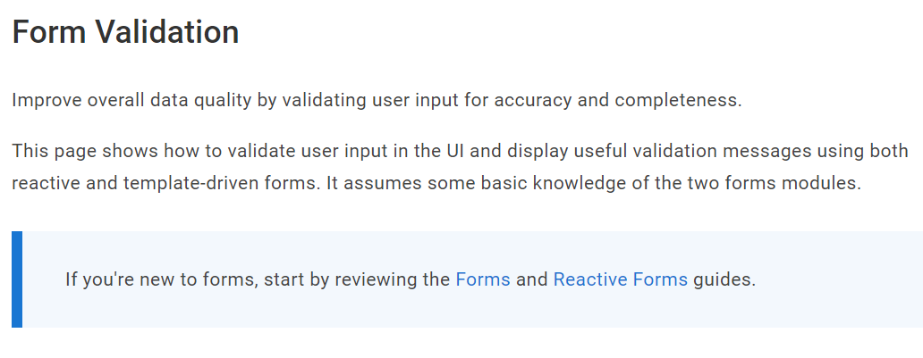
Angular Validation

Slide 38
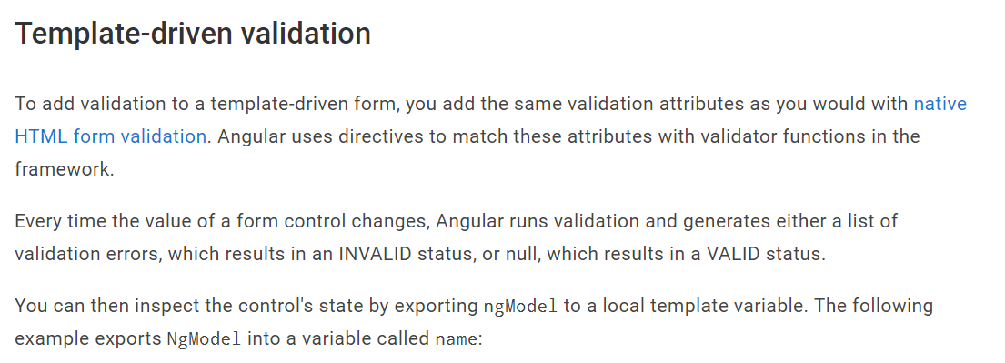

Slide 39
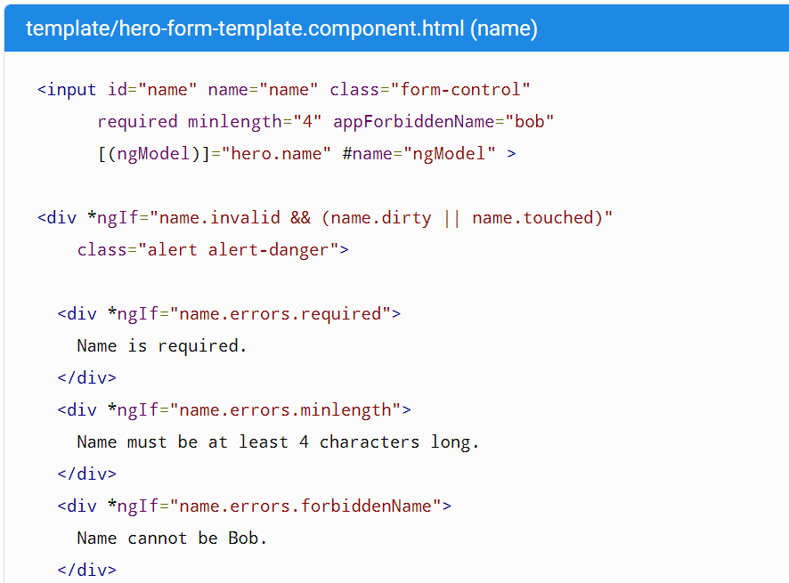

Slide 40
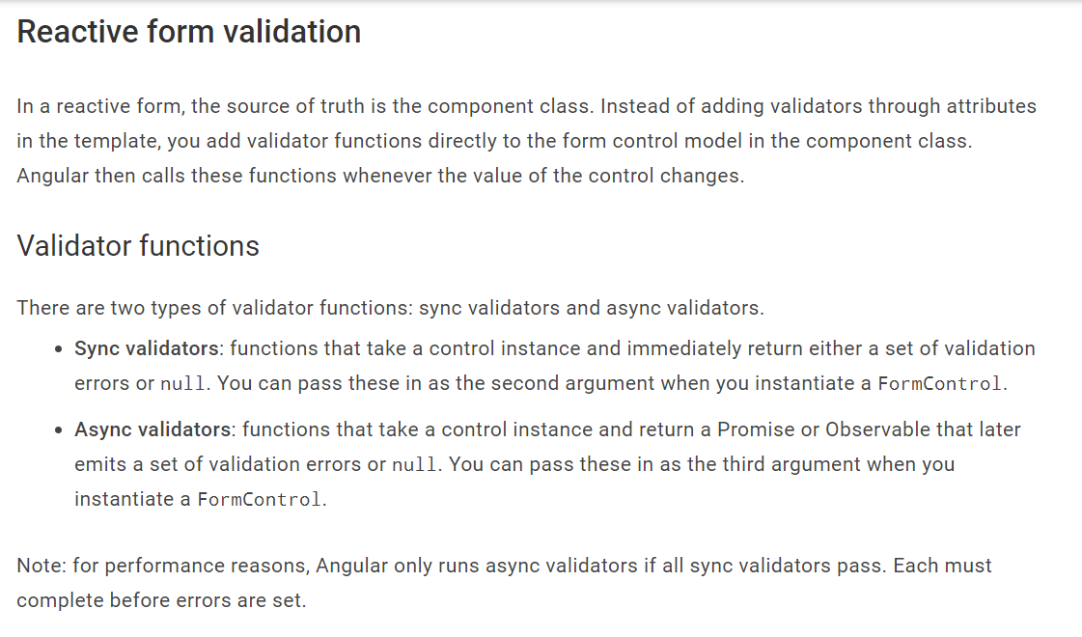

Slide 41
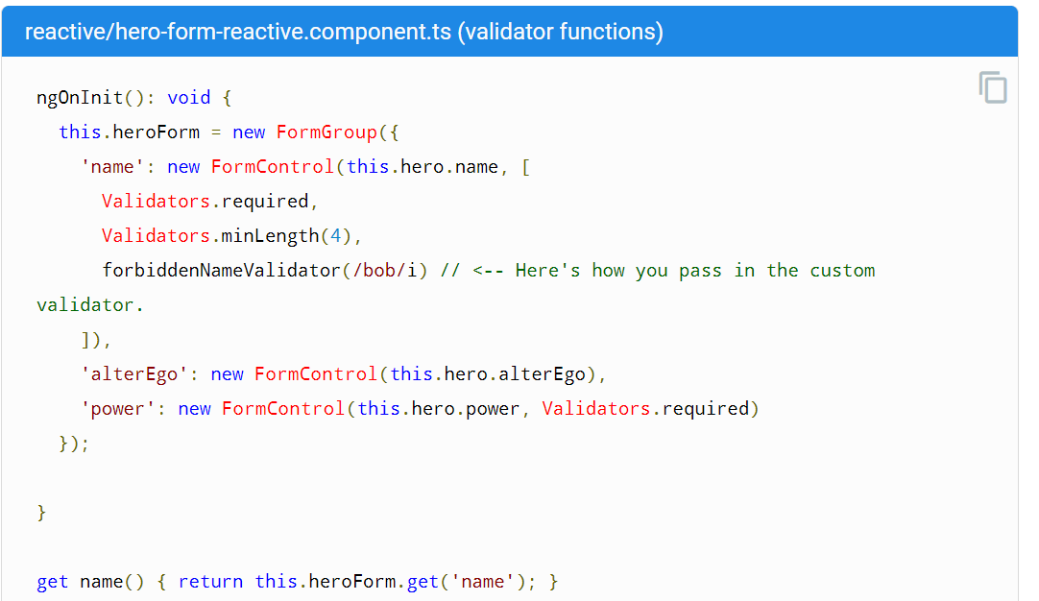

Slide 42
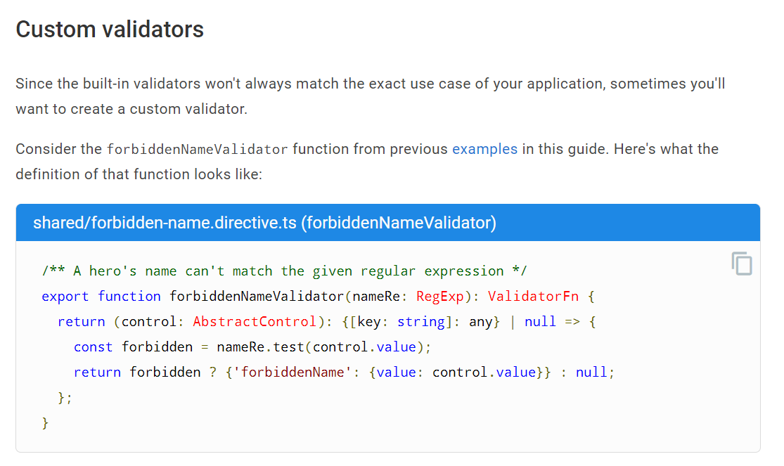

Slide 43
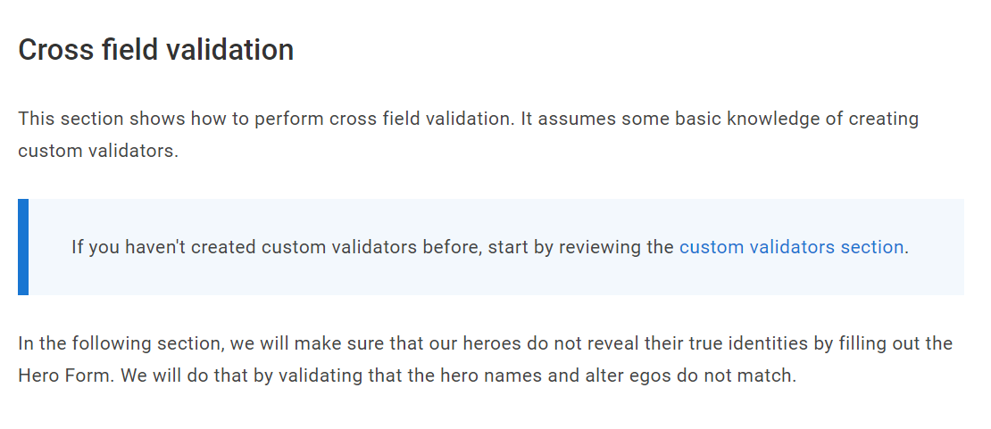

Slide 44
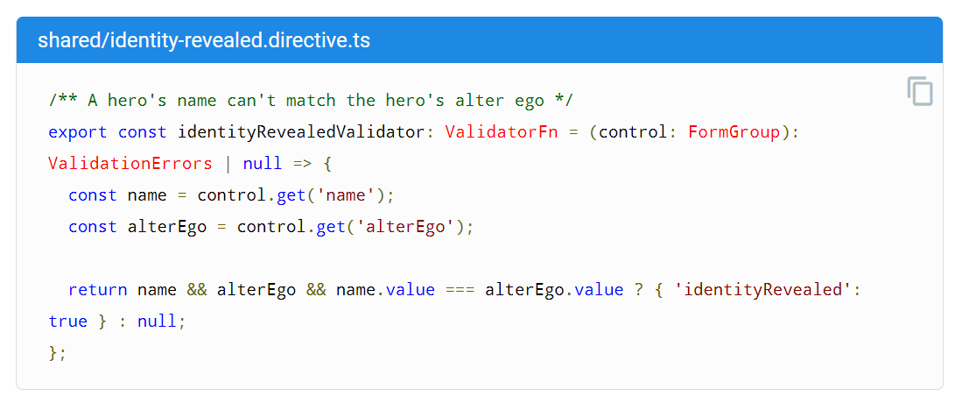

Slide 45
Thanks

